Slide 1
Stonnall Campaigns About Roads
31/03/2023

Slide 2
Latest Update:
Walsall council plan to develop their own WLP (Walsall Local Plan).
This plan will be based on the BCP (Black Country Plan) and will most likely adopt the proposed development sites.
Lichfield has submitted its housing offer of approximately 2000 homes.
Sept 2023 the WLP should be available for consultation.
Sept 2024 final consultation of the WLP
March 2026 WLP submitted
Microsoft Word - 5. Black Country Plan - Walsall Local Plan
Walsall Site Allocation Document - Adopted January 2019
Local Plans Policies Map Adopted.pdf (walsall.gov.uk)

Slide 3
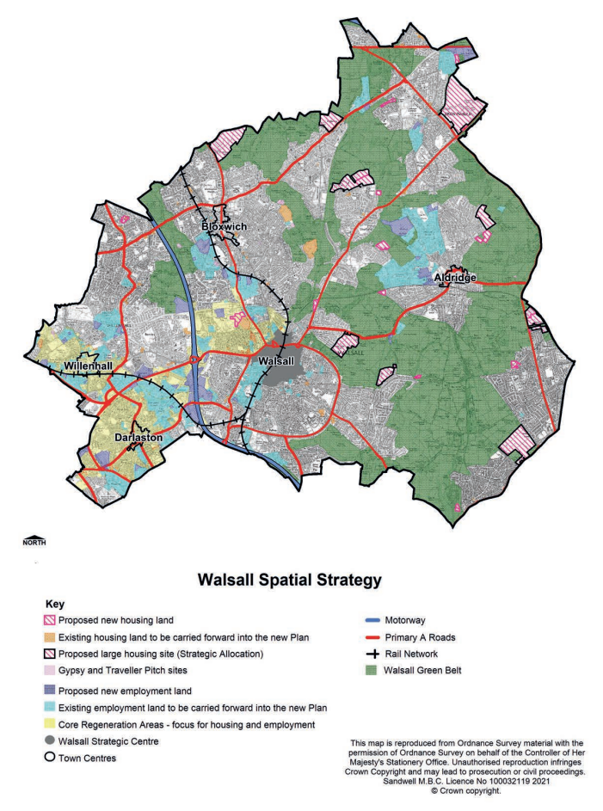
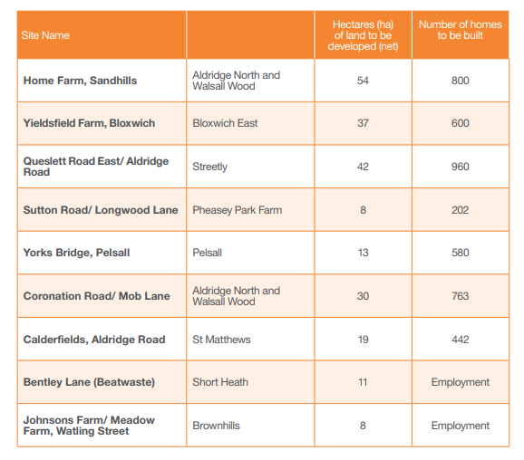
Home Farm ~ 800 by 2039, total capacity 1,417
Pacific Nurseries ~ 415
Queslett Road ~ 1480
Stonnall Road ~ 363
Draft Black Country Plan 2039 (Regulation 18) Consultation | Black Country Plan (dudley.gov.uk)

Slide 4
Design Code
Lichfield District Council is seeking to engage with members of the local community on the production of a new district-wide Design Code.
A design code is a tool that can be used by local planning authorities, communities, and developers to deliver high quality places. It will provide clear rules for new development to adhere to, including building heights, conservation and sustainability, among other topics. The document will be built upon the 10 specific features for good design defined in the National Model Design Code. Once adopted, the Lichfield District Design Code can be used to judge new planning applications.
COMMUNITY SURVEY – YOUR INPUT
The survey aims to gather information from local people and provides an opportunity for you to help us produce the Design Code. We want to ensure that the code addresses the things which are important to local people.
The online questionnaire contains a range of questions to help you analyse the character of your area. Your contribution will help us understand the distinct features of various locations in Lichfield District. You may complete the questionnaire individually or as a group.
To encourage participation, all participants in the Community Survey will be entered into a draw for one winner to receive a high street shopping voucher worth £100.
Recorded Community Webinar
The survey is accessed through Survey Monkey and is accessible by clicking on the following link.
Lichfield District Design Code Community Survey
National Model Design Code: Part 1 - The Coding Process (publishing.service.gov.uk)

Slide 5
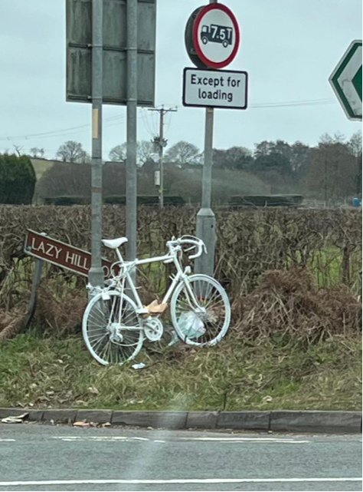
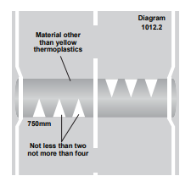
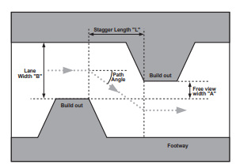
Road Safety or Lack Of It !
The report is very detailed on the effectiveness of different types of traffic calming measures, clearly the cushions we have are not very effective.
Full surface humps are the most effective, pinch points only work well with higher volumes of traffic.
Single lane chicanes are very effective in slowing vehicles into a village but must consider buses / farm traffic (these have been deployed in Hammerwich & Kings Bromley effectively)
Traffic Calming (publishing.service.gov.uk)

